Slide 1
The Menzerath-Altmann Law and Ancient Hebrew: Does the Bible Break the Law?
Jarod Jacobs

Slide 2
MAL: Summary
“The larger the whole the smaller the parts” (Menzerath 1954: 100)
“The longer a language construct the shorter its components (constituents)”
Example: On average longer sentences (by number of clauses) will have shorter clauses (by number of phrases), while shorter sentences will have longer clauses.
Theorized that this law is related to the economization principles of language processing, specifically the principle of minimizing memory.

Slide 3
MAL: Summary
Differential Equation: y¹ = c *y/x
This Function presents the solution to the differential equation: y = ax^{b}e^{−cx}
The simplified form: y = ax^{b}

Slide 4
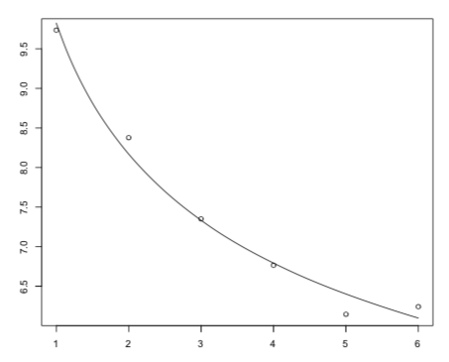
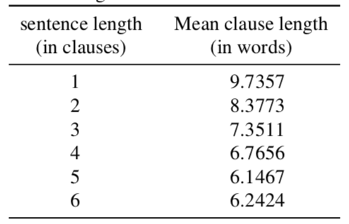
MAL: Examples
SENTENCE LEVEL: GERMAN AND ENGLISH SHORT STORIES AND PHILISOPHICAL TEXTS (KÖHLER 1982)
R2 = 0.9858

Slide 5
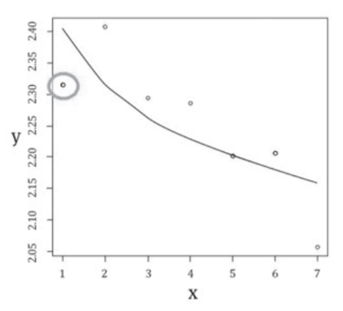
MAL: Examples
Benesova et al. - Czech text: Olomouc Speech Corpus
R2 = 0.5710

Slide 6
Methodology and Tools
Eep Talstra Center for Bible and Computer
SHEBANQ and Text-Fabric
Python
Github.com/jarodjacobs

Slide 7
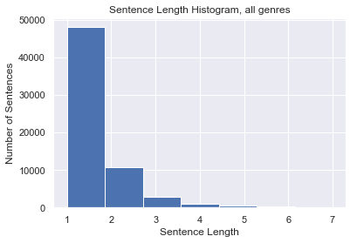
Corpora
Linguistically annotated Biblia Hebraica Stuttgartensia
1QM and 1QS
Sentence
BHS – 63,570; 1QM/S – 1,481
Clause
BHS – 88,000; 1QM/S – 2,210
Phrase
BHS – 253,174; 1QM/S – 5,793
Word
BHS – 426,581; 1QM/S – 12,071
Letter
BHS – 1,197,766, 1QM/S – 31,651

Slide 8
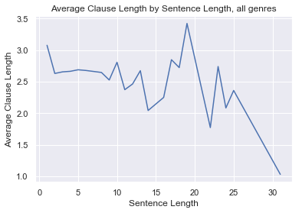
Corpora
Linguistically annotated Biblia Hebraica Stuttgartensia
1QM and 1QS
Sentence
BHS – 63,570; 1QM/S – 1,481
Clause
BHS – 88,000; 1QM/S – 2,210
Phrase
BHS – 253,174; 1QM/S – 5,793
Word
BHS – 426,581; 1QM/S – 12,071
Letter
BHS – 1,197,766, 1QM/S – 31,651

Slide 9
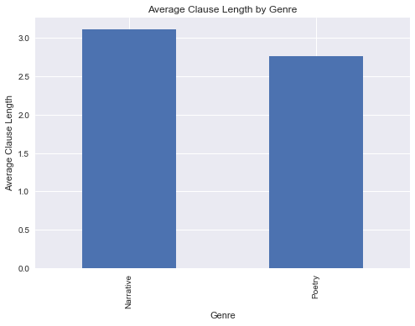
Corpora
Linguistically annotated Biblia Hebraica Stuttgartensia
1QM and 1QS
Sentence
BHS – 63,570; 1QM/S – 1,481
Clause
BHS – 88,000; 1QM/S – 2,210
Phrase
BHS – 253,174; 1QM/S – 5,793
Word
BHS – 426,581; 1QM/S – 12,071
Letter
BHS – 1,197,766, 1QM/S – 31,651

Slide 10
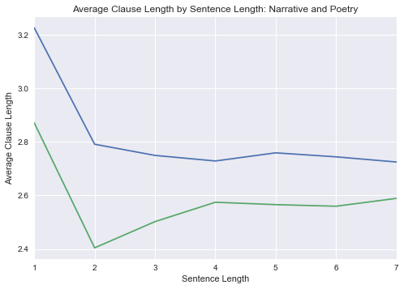
Corpora
Linguistically annotated Biblia Hebraica Stuttgartensia
1QM and 1QS
Sentence
BHS – 63,570; 1QM/S – 1,481
Clause
BHS – 88,000; 1QM/S – 2,210
Phrase
BHS – 253,174; 1QM/S – 5,793
Word
BHS – 426,581; 1QM/S – 12,071
Letter
BHS – 1,197,766, 1QM/S – 31,651

Slide 11
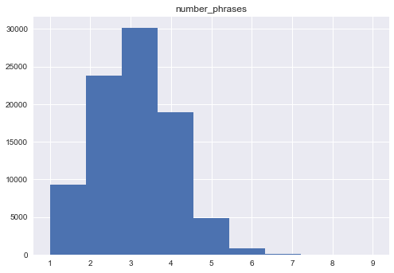
Corpora
Linguistically annotated Biblia Hebraica Stuttgartensia
1QM and 1QS
Sentence
BHS – 63,570; 1QM/S – 1,481
Clause
BHS – 88,000; 1QM/S – 2,210
Phrase
BHS – 253,174; 1QM/S – 5,793
Word
BHS – 426,581; 1QM/S – 12,071
Letter
BHS – 1,197,766, 1QM/S – 31,651

Slide 12
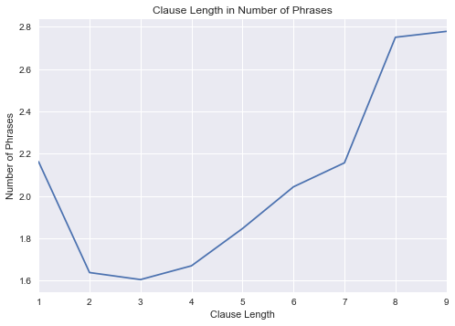
Corpora
Linguistically annotated Biblia Hebraica Stuttgartensia
1QM and 1QS
Sentence
BHS – 63,570; 1QM/S – 1,481
Clause
BHS – 88,000; 1QM/S – 2,210
Phrase
BHS – 253,174; 1QM/S – 5,793
Word
BHS – 426,581; 1QM/S – 12,071
Letter
BHS – 1,197,766, 1QM/S – 31,651

Slide 13
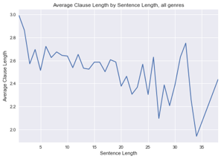
Corpora
Linguistically annotated Biblia Hebraica Stuttgartensia
1QM and 1QS
Sentence
BHS – 63,570; 1QM/S – 1,481
Clause
BHS – 88,000; 1QM/S – 2,210
Phrase
BHS – 253,174; 1QM/S – 5,793
Word
BHS – 426,581; 1QM/S – 12,071
Letter
BHS – 1,197,766, 1QM/S – 31,651

Slide 14
Corpora
Linguistically annotated Biblia Hebraica Stuttgartensia
1QM and 1QS
Sentence
BHS – 63,570; 1QM/S – 1,481
Clause
BHS – 88,000; 1QM/S – 2,210
Phrase
BHS – 253,174; 1QM/S – 5,793
Word
BHS – 426,581; 1QM/S – 12,071
Letter
BHS – 1,197,766, 1QM/S – 31,651

Slide 15
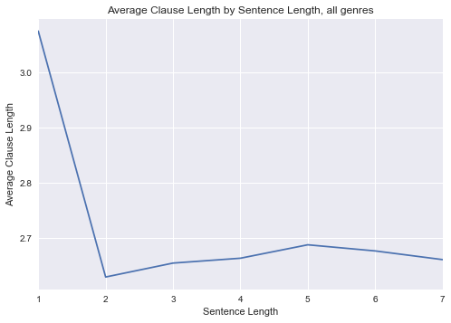
Results: Sentence Level
Sentence Length | Average Clause Length
1 | 3.075193
2 | 2.629325
3 | 2.654567
4 | 2.663388
5 | 2.687727
6 | 2.676617
7 | 2.660881

Slide 16
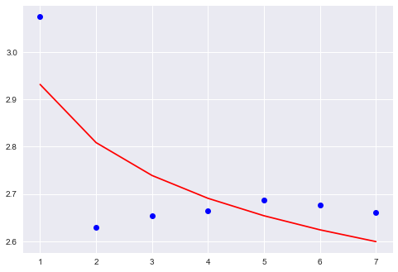
Results: Sentence Level
R² = 0.501

Slide 17
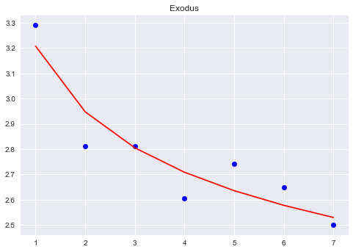
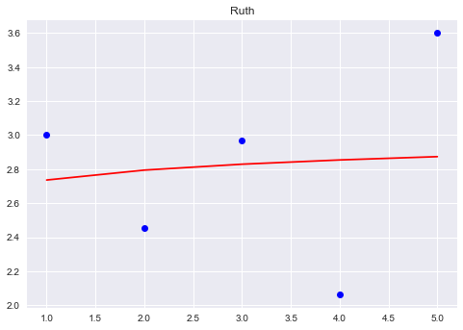
Results: Sentence Level
Exodus R² = 0.843
Ruth R² = 0.001

Slide 18
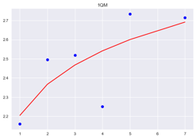
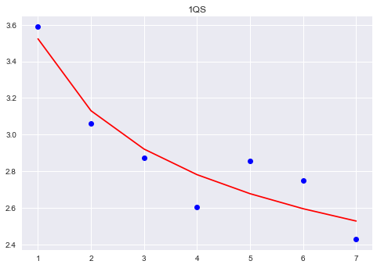
Results: Sentence Level
1QM R² = 0.538
1QS R² = 0.857

Slide 19
Results: Sentence Level
1QM R² = 0.538
1QS R² = 0.857

Slide 20
Results: Clause Level
Clause Length | Phrase Length
1 | 2.162078
2 | 1.63794
3 | 1.604729
4 | 1.669904
5 | 1.845819
6 | 2.043144
7 | 2.156522
8 | 2.75
9 | 2.777778

Slide 21
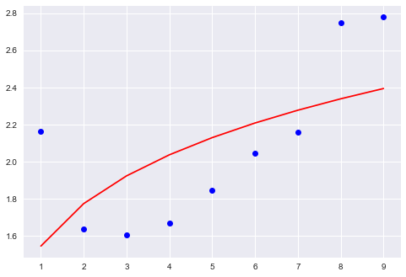
Results: Clause Level
R² = 0.294

Slide 22
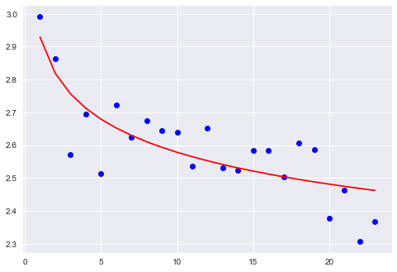
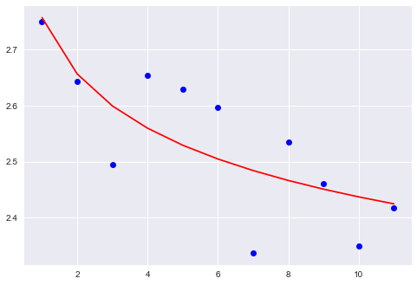
Results: Phrase Level
BHS - R² = 0.655
1QM/S - R² = 0.601

Slide 23
Results: Summary
Sentence - R² = 0.501
Clause - R² = 0.294
Phrase - R² = 0.655

